Slide 1
One-to-One
Primary key
Foreign key
Primary key
Cars
Drivers
CarID | DriverID
1 | 166
2 | 102
DriverID | DriverName
166 | ..
102 | …
Relationship
Notes:
In One-to-One relationship each row of table Cars is related to exactly zero or one row in table Drivers. In table Cars.DriverID is a foreign key which means that there will be a relation to another table – Drivers in the case. Table Drivers has a column DriverID as well which is a primary key. The relation is always between a foreign key and a primary key. It means that all values in Cars.DriverID should be present in Drivers. DriverID except NULL. Cars.DriverID can be NULL if it is not stated otherwise.

Slide 2
Setup
Table Drivers
CREATE TABLE Drivers(
DriverID INT PRIMARY KEY,
DriverName VARCHAR(50)
)
CREATE TABLE Cars(
CarID INT PRIMARY KEY,
DriverID INT UNIQUE,
CONSTRAINT FK_Car_Driver FOREIGN KEY(DriverID) REFERENCES Drivers(DriverID) )
Table Cars
Foreign Key

Slide 3
Foreign Key
Constraint Name
CONSTRAINT FK_Cars_Drivers FOREIGN KEY (DriverID) REFERENCES Drivers(DriverID)
Foreign Key
Referent Table
Primary Key

Slide 4
One-to-Many/Many-to-One
Primary key
Primary key
Foreign key
Mountains
Peaks
MountainID | Name
5 | Caucasus
PeakID | MountainID
61 | 5
66 | 5
Relationship
Notes:
One-to-Many relationship means that each row from a table is related zero, one or many rows in the referent table. In the case above, each mountain can have 0, 1 or many peaks. The example shows that the mountain Caucasus has two peaks - One-to-Many. If you look the other way around many peaks has exactly one mountain – Many-to-One.

Slide 5
Setup
Table Mountains
CREATE TABLE Mountains(
MountainID INT PRIMARY KEY,
MountainName VARCHAR(50)
)
CREATE TABLE Peaks(
PeakId INT PRIMARY KEY,
MountainID INT,
CONSTRAINT FK_Peaks_Mountains FOREIGN KEY (MountainID) REFERENCES Mountains(MountainID) )
Table Peaks
Foreign Key

Slide 6
Foreign Key
Constraint Name
CONSTRAINT FK_Peaks_Mountains FOREIGN KEY (MountainID) REFERENCES Mountains(MountainID)
Foreign Key
Referent Table
Primary Key

Slide 7
Many-to-Many
Primary key
Primary key
Employees
Projects
EmployeeID | EmployeeName
1 | …
40 | …
Relationship
ProjectID | ProjectName
4 | ..
24 | …
Mapping table
EmployeesProjects
EmployeeID | ProjectID
1 | 4
1 | 24
40 | 24
Notes:
Many-to-Many relationship relates many rows from a table to many rows in another table. For example. Employee.EmployeeID has many projects. Many projects are assigned to many employees which is the other way around. Usually we have a mapping table that takes care of the relations.

Slide 8
Setup
Table Employees
Table Projects
CREATE TABLE Employees(
EmployeeID INT PRIMARY KEY,
EmployeeName VARCHAR(50)
)
CREATE TABLE Projects(
ProjectID INT PRIMARY KEY,
ProjectName VARCHAR(50)
)
Table EmployeesProjects
CREATE TABLE EmployeesProjects(
EmployeeID INT,
ProjectID INT,
CONSTRAINT PK_EmployeesProjects PRIMARY KEY(EmployeeID, ProjectID),
CONSTRAINT FK_EmployeesProjects_Employees FOREIGN KEY(EmployeeID) REFERENCES Employees(EmployeeID),
CONSTRAINT FK_EmployeesProjects_Projects FOREIGN KEY(ProjectID) REFERENCES Projects(ProjectID)
)
Primary Key
Foreign Key
Foreign Key

Slide 9
Foreign Key
Primary Key
CONSTRAINT PK_EmployeesProjects PRIMARY KEY(EmployeeID, ProjectID),
CONSTRAINT FK_EmployeesProjects_Employees FOREIGN KEY(EmployeeID) REFERENCES Employees(EmployeeID),
CONSTRAINT FK_EmployeesProjects_Projects FOREIGN KEY(ProjectID) REFERENCES Projects(ProjectID)
Foreign Key
Referent Table
Foreign Key
Referent Table

Slide 10
Foreign Key Update Cascade
Table Drivers
CREATE TABLE Drivers(
DriverID INT PRIMARY KEY,
DriverName VARCHAR(50)
)
CREATE TABLE Cars(
CarID INT PRIMARY KEY,
DriverID INT,
CONSTRAINT FK_Car_Driver FOREIGN KEY(DriverID) REFERENCES Drivers(DriverID) ON UPDATE CASCADE )
Table Cars
Foreign Key
Cascade

Slide 11
Foreign Key Delete Cascade
Table Drivers
CREATE TABLE Drivers(
DriverID INT PRIMARY KEY,
DriverName VARCHAR(50)
)
CREATE TABLE Cars(
CarID INT PRIMARY KEY,
DriverID INT,
CONSTRAINT FK_Car_Driver FOREIGN KEY(DriverID) REFERENCES Drivers(DriverID) ON DELETE CASCADE )
Table Cars
Foreign Key
Cascade

Slide 12
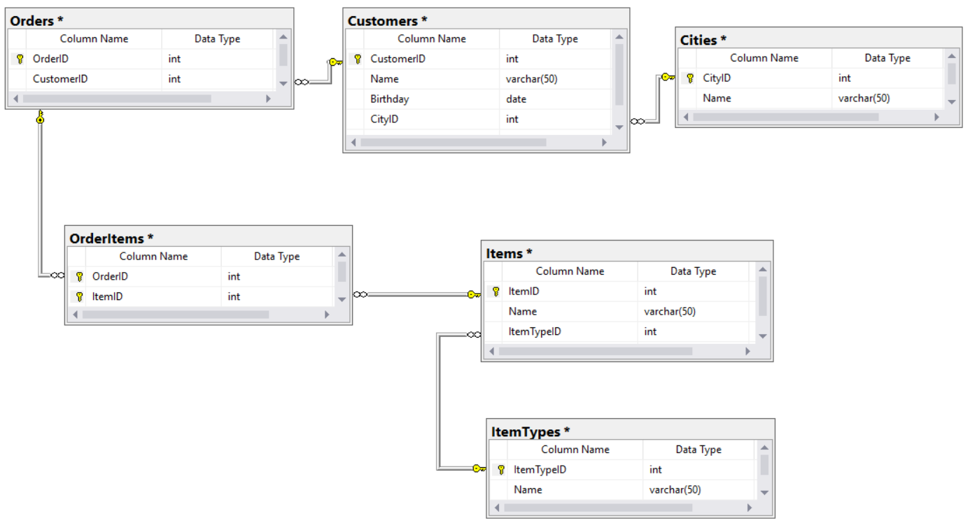
E/R Diagram
Notes:
E/R diagrams represent the tables which are called entities and the relationships between them. They are used as a technical illustration of the database design.

Slide 13


JOINS

Slide 14
Inner Join
Employees
Departments
EmployeeID | DepartmentID
263 | 3
270 | NULL
Inner Join
DepartmentID | DepartmentName
3 | Sales
4 | Marketing
5 | Purchasing
Notes:
Inner joins return only rows which exist in both tables.

Slide 15
Inner Join Syntax
Table Employees
SELECT *
FROM Employees AS e
INNER JOIN Departments AS d
ON e.DepartmentID = d.DepartmentID
Table Depatments
Inner Join
Join Conditions

Slide 16
Inner Join
Employees
Departments
EmployeeID | DepartmentID
263 | 3
270 | NULL
Inner Join
DepartmentID | DepartmentName
3 | Sales
4 | Marketing
5 | Purchasing
Result
EmployeeID | DepartmentID | DepartmentID | DepartmentName
263 | 3 | 3 | Sales
Notes:
Inner joins return only rows which exist in both tables.

Slide 17
Left Outer Join
Employees
Departments
EmployeeID | DepartmentID
263 | 3
270 | NULL
Left Join
DepartmentID | DepartmentName
3 | Sales
4 | Marketing
5 | Purchasing
X
Notes:
Left outer joins return all the data in the first(left) table and all the data from the second(right) table that matches the join conditions. If the data in the right table doesn’t match any data in the left table the return value is NULL.

Slide 18
Left Outer Join Syntax
Table Employees
SELECT *
FROM Employees AS e
LEFT OUTER JOIN Departments AS d
ON e.DepartmentID = d.DepartmentID
Table Depatments
Left Join
Join Conditions

Slide 19
Left Outer Join
Employees
Departments
EmployeeID | DepartmentID
263 | 3
270 | NULL
Left Join
DepartmentID | DepartmentName
3 | Sales
4 | Marketing
5 | Purchasing
X
Result
EmployeeID | DepartmentID | DepartmentID | DepartmentName
263 | 3 | 3 | Sales
270 | NULL | NULL | NULL
Notes:
Left outer joins return all the data in the first(left) table and all the data from the second(right) table that matches the join conditions. If the data in the right table doesn’t match any data in the left table the return value is NULL.

Slide 20
Right Outer Join
Employees
Departments
EmployeeID | DepartmentID
263 | 3
270 | NULL
Right Join
DepartmentID | DepartmentName
3 | Sales
4 | Marketing
5 | Purchasing
X
X
Notes:
Right outer joins return all the data in the second(right) table and all the data from the first(left) table that matches the join conditions. If the data in the left table doesn’t match any data in the right table the return value is NULL.

Slide 21
Right Outer Join Syntax
Table Employees
SELECT *
FROM Employees AS e
RIGHT OUTER JOIN Departments AS d
ON e.DepartmentID = d.DepartmentID
Table Depatments
Right Join
Join Conditions

Slide 22
Right Outer Join
Employees
Departments
EmployeeID | DepartmentID
263 | 3
270 | NULL
Right Join
DepartmentID | DepartmentName
3 | Sales
4 | Marketing
5 | Purchasing
X
X
Result
EmployeeID | DepartmentID | DepartmentID | DepartmentName
263 | 3 | 3 | Sales
NULL | NULL | 4 | Marketing
NULL | NULL | 5 | Purchasing
Notes:
Right outer joins return all the data in the second(right) table and all the data from the first(left) table that matches the join conditions. If the data in the left table doesn’t match any data in the right table the return value is NULL.

Slide 23
Full Join
Employees
Departments
EmployeeID | DepartmentID
263 | 3
270 | NULL
Full Join
DepartmentID | DepartmentName
3 | Sales
4 | Marketing
5 | Purchasing
X
X
Notes:
Full joins match all the data in the left and the right table. If any of the values doesn’t the join conditions the return value is NULL.

Slide 24
Full Join Syntax
Table Employees
SELECT *
FROM Employees AS e
FULL JOIN Departments AS d
ON e.DepartmentID = d.DepartmentID
Table Depatments
Full Join
Join Conditions

Slide 25
Full Join
Employees
Departments
EmployeeID | DepartmentID
263 | 3
270 | NULL
Full Join
DepartmentID | DepartmentName
3 | Sales
4 | Marketing
5 | Purchasing
X
X
Result
EmployeeID | DepartmentID | DepartmentID | DepartmentName
263 | 3 | 3 | Sales
270 | NULL | NULL | NULL
NULL | NULL | 4 | Marketing
NULL | NULL | 5 | Purchasing
Notes:
Full joins match all the data in the left and the right table. If any of the values doesn’t the join conditions the return value is NULL.

Slide 26
Cross join
Employees
Departments
EmployeeID | DepartmentID
263 | 3
270 | NULL
Cross Join
DepartmentID | DepartmentName
3 | Sales
4 | Marketing
5 | Purchasing
Notes:
Cross joins create Cartesian products. This means that all the rows in the left table are multiplied by all the rows in the right table. If table Employees has 2 rows and table Departments has 3 rows the result will return the multiplication – 6 rows.

Slide 27
Cross Join Syntax
Table Employees
SELECT *
FROM Employees AS e
CROSS JOIN Departments AS d
Table Depatments
Cross Join
No Join Conditions

Slide 28
Cross join
Employees
Departments
EmployeeID | DepartmentID
263 | 3
270 | NULL
Cross Join
DepartmentID | DepartmentName
3 | Sales
4 | Marketing
5 | Purchasing
Result
EmployeeID | DepartmentID | DepartmentID | DepartmentName
263 | 3 | 3 | Sales
263 | 3 | 4 | Marketing
263 | 3 | 5 | Purchasing
270 | NULL | 3 | Sales
270 | NULL | 4 | Marketing
270 | NULL | 5 | Purchasing
Notes:
Cross joins create Cartesian products. This means that all the rows in the left table are multiplied by all the rows in the right table. If table Employees has 2 rows and table Departments has 3 rows the result will return the multiplication – 6 rows.

Slide 29
Natural join
Employees
Departments
EmployeeID | DepartmentID
263 | 3
270 | NULL
Natural Join
DepartmentID | DepartmentName
3 | Sales
4 | Marketing
5 | Purchasing
Automatic
Notes:
Natural joins are similar to inner joins. However, you don’t specify join conditions. The join happens automatically if two of the columns have the same name. Using natural joins is a bad practice.

Slide 30
Natural Join Syntax
Table Employees
SELECT *
FROM Employees AS e
NATURAL JOIN Departments AS d
Table Depatments
Natural Join
Auto Join Conditions

Slide 31
Natural join
Employees
Departments
EmployeeID | DepartmentID
263 | 3
270 | NULL
Natural Join
DepartmentID | DepartmentName
3 | Sales
4 | Marketing
5 | Purchasing
Automatic
Result
EmployeeID | DepartmentID | DepartmentID | DepartmentName
263 | 3 | 3 | Sales
Notes:
Natural joins are similar to inner joins. However, you don’t specify join conditions. The join happens automatically if two of the columns have the same name. Using natural joins is a bad practice.

Slide 32

Subqueries

Slide 33
Subqueries
Employees
Query
EmployeeID | Salary
59 | 19,000
71 | 43,300
... | ...
Subquery
WHERE EmployeeID IN
DepartmentID | Name
10 | Finance
Notes:
A subquery or nested query is a query within another SQL query and embedded within the WHERE clause. Its main purpose is to serve as a data filter for the main query. It can be used after any of the operators(>,<, =, !=, IN, BETWEEN). A subquery can return a single value or multiple values.

Slide 34
Subquery Syntax
Table Employees
SELECT *
FROM Employees AS e
WHERE e.DepartmentID IN
(SELECT d.DepartmentID
FROM Departments AS d
WHERE d.Name = 'Finance')
Table Depatments
Subquery

Slide 35
Subquery Syntax
SELECT MIN(a.AverageSalary) AS MinAverageSalary
FROM (
SELECT e.DepartmentID,
AVG(e.Salary) AS AverageSalary
FROM Employees AS e
GROUP BY e.DepartmentID
) AS a
Table Employees
Subquery

Slide 36

Indices

Slide 37
Indices
EmployeeID
0 - 200
0 – 100
101-200
101-150
50-100
0-50
150-200
Notes:
Every table can have only one clustered indexes. They are stored on the table. Clustered indexes sorts the data physically in the table so the reads are much faster. The most common index structure are the B-trees. However, when you have an index inserts and deletes it takes more time to accomplish because indexes has to be updated as well. A non-clustered index has a duplicate of the data from the indexed columns kept ordered together with pointers to the actual data rows (pointers to the clustered index if there is one). This means that accessing data through a non-clustered index has to go through an extra layer of indirection. However, if you select only the data that's available in the indexed columns you can get the data back directly from the duplicated index data.

Slide 38
Indices Syntax
Index Type
CREATE NONCLUSTERED INDEX IX_Employees_FirstName_LastName
ON Employees(FirstName, LastName)
MSSQL
Table Name
Columns
CREATE INDEX ix_employees_first_name_last_name
ON employees(first_name, last_name)
MySQL
Table Name
Columns

Slide 39

Summary
Relations
Joins
Subqueries
Indices

Slide 40









Table Relations
https://softuni.bg/courses/

Slide 41

License
This course (slides, examples, demos, videos, homework, etc.) is licensed under the "Creative Commons Attribution-NonCommercial-ShareAlike 4.0 International" license
Attribution: this work may contain portions from
"Fundamentals of Computer Programming with C#" book by Svetlin Nakov & Co. under CC-BY-SA license
"C# Part I" course by Telerik Academy under CC-BY-NC-SA license

Slide 42






Free Trainings @ Software University
Software University Foundation – softuni.org
Software University – High-Quality Education, Profession and Job for Software Developers
softuni.bg
Software University @ Facebook
facebook.com/SoftwareUniversity
Software University @ YouTube
youtube.com/SoftwareUniversity
Software University Forums – forum.softuni.bg

